Slide 1
Tabulation Method

Slide 2
The Tabulation Method
As the number of variables increases, the excessive number of squares prevents a reasonable selection of adjacent squares.
Tabulation method overcomes this difficulty.
Also Known as Quine – Mccluskey Method
It is suitable for machine computation
2 parts
Determination of prime implicants
Construct prime implicant table and Select essential prime-implicants

Slide 4
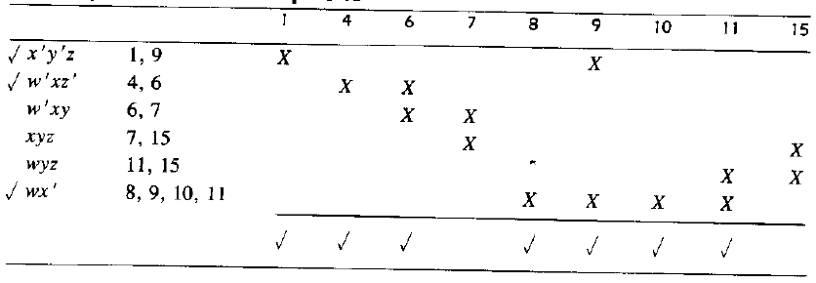
Selection of Prime Implicants

Slide 5
Determination of prime implicants

Slide 6
Determination of prime implicants with decimal notation

Slide 7
Tabulation Method
Find POS for the function F(A,B,C,D)= ( 5, 6 , 7 , 8 , 9 , 12 , 13 , 14 , 15)

Slide 8
References
M.Morris Mano, “Digital Design”, 3rd Edition

